Slide 1

EXCEL AUTOMATION USING
BLUE PRISM
Project Supervisor:Dr.A.MARY POSONIA ,M.E.,Ph.D .,
Name of the Student: Mr. Arul David J
Register Number:39110083

Slide 2
Presentation Outline
Course Certificate
Introduction
Objectives
System Architecture / Ideation Map
Module Implementation
Application Snapshots
Results and Discussions
Conclusion & Future work
References

Slide 3
Course Certificate
Attach your Course Certificate here

Slide 4
Introduction
In this project, we will build a process to Grade Calculation Excel Automation that works
over Microsoft Excel 2013 using Blue prism
Generally , in order to calculate grades we use manual formulas in Excel .We also need to enter
the marks manually each time. Our goal through this project is to automate this whole process
with the help of RPA technology and Blueprism. We can avoid doing the rote and recurring
task of calculating grade for each student based on their marks repeatedly and save time with
the help of this project.

Slide 5
Objectives
Blue Prism is an RPA Tool which holds the capability of virtual workforce powered by software robots.
This helps the enterprises to automate the business operations in an agile and cost-effective manner.
The tool is based on Java Programming Language and offers a visual designer with drag and drop functionalities.

Slide 6
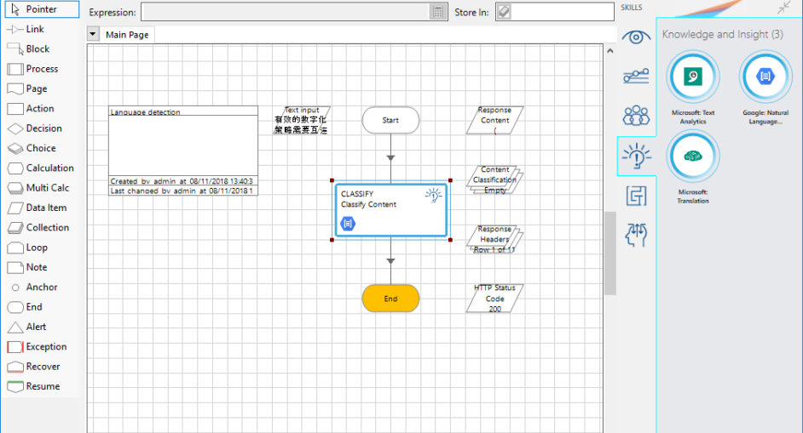
System Architecture / Ideation Map

Slide 7
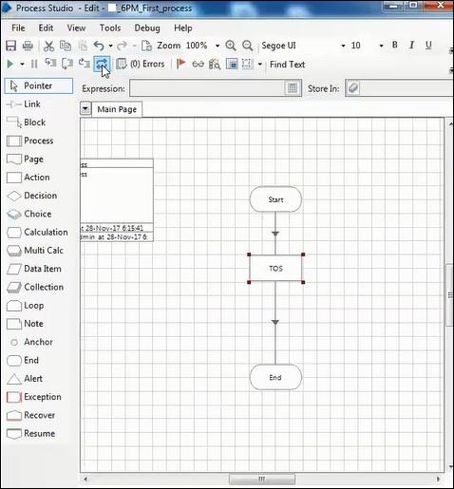
Diagram

Slide 8
Project Implementation
First design your project either by Simulation
By the end of this project you will:
.Importing MS Excel VBO(Visual Basic for Applications) in Blue Prism.
Tuning Process Studio with specific needs.
Working with different stages in the Process studio
Importing Blue Prism MS Excel VBO (Visual Basic for Applications)
Binding Process Studio with MS Excel VBO.
Opening MS Excel WorkBook.

Slide 9
Methodology
Method of approach should be presented clearly with its outline and justification. Blue Prism is deployed using a grid based virtualised runtime and control methodology, where lightweight Blue Prism resources are interconnected within the data centre through a series of Blue Prism server components to a back end database.
? Internet connection to download and activate
? Administration access to install and run Blue Prism
? Minimum 10GB free disk space
? Windows 8.1 or 10 (64-bit version only) OR Cloud: Get started free, *Cloud account required.
Your methodology should also describe your objective and how you are going to achieve your objective.

Slide 10
Methodology
500 megahertz (MHz)
256 megabytes (MB) RAM
1.5 gigabytes (GB) available space
1024x768 or higher resolution monitor
We test our software against multiple operating systems and configurations to ensure compatibility with the currently available versions. We evaluate our software against the versions listed in the tables below and highlight the most appropriate selections as recommended versions
Coding using RPA API and other API tools
Native actions for Excel automation
Object-based automation

Slide 11
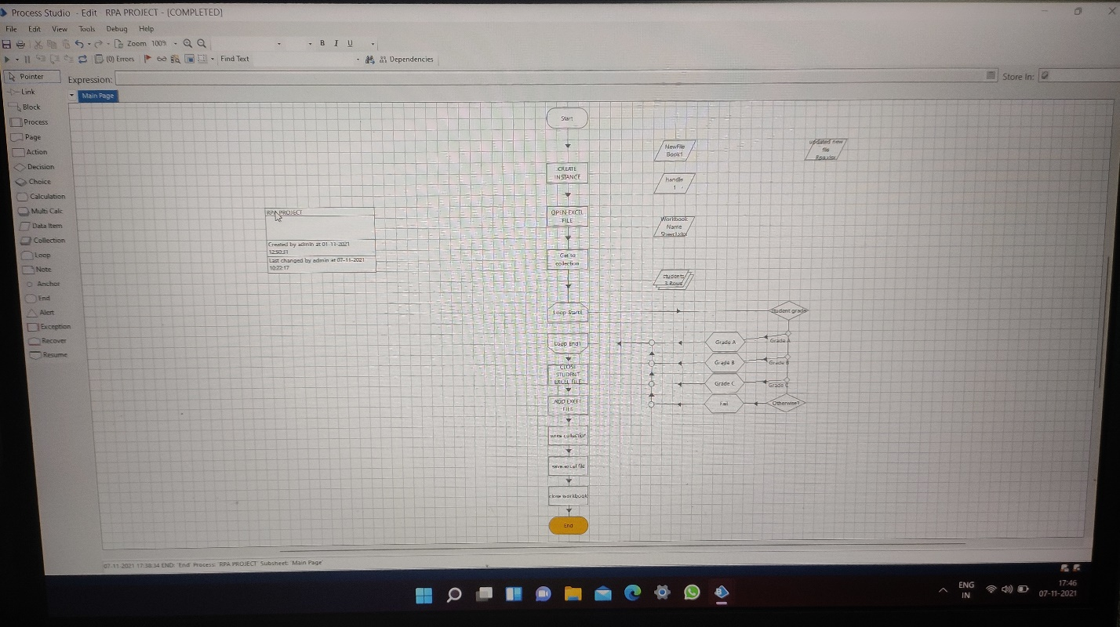
Results and Discussion
Flow chart

Slide 12
Discussion
1. Create Action Stage as “Close Student excel file (Business Object = MS Excel VBO; Action = Close WorkBook).
a. Click on the Inputs tab
i. Drag “handle” data item into handle Value column.
ii. Drag “Workbook Name” data item into the Workbook Name Value column.
iii. Save Data as “False”.
Create Action as “Create Output excel file” (Business Object = MS Excel VBO; Action = Create WorkBook).
a. Click on the Inputs tab.
i. Drag “handle” data item into handle Value column.
b. Click on the Outputs tab
i. Create Data Item, type = Text, name =”NewFile''.
ii. Drag it into the Workbook Name Store In column. Click on ok.

Slide 13
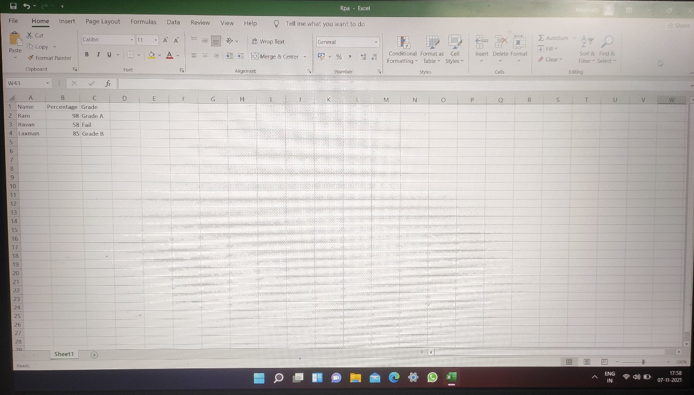
Output
All the flows was executed successfully by reading the given excel sheet and the output was stored new excel document as output.

Slide 14
Conclusion
The analytical process started from data cleaning and processing, missing value, exploratory analysis and finally model building and evaluation.
It has become easy to find out relation and patterns among various data’s.
Object Studio is designed to help you create small modular units for interacting with end-user applications.
Object Studio opens this opportunity up to the business user, as well as the technical expert

Slide 15
Conclusion
In most cases, Blue Prism will be able to detect that the application element that you have identified using the spy tool is a button
In the excel automation we had to find the excel
arrengement in the same purpose in all categeory.
We test our software against multiple operating systems and configurations to ensure compatibility with the currently available versions

Slide 16
Software required
Recommended
Minimum
Microsoft .NET Framework 4.8
Microsoft .NET Framework 4.7.2 or above
Recommended
Deprecated
SQL 2016 (64-bit)
SQL 2017 (64-bit)
SQL 2019 (64-bit)
Azure SQL Database V12
SQL 2012 inc. R2 (32-bit/64-bit)
SQL 2014 inc. R2 (32-bit/64-bit)

